Slide 1
SQ3R METHOD
How do 26 letters cause so much trouble?
Copyright
AeroSTEM Consulting, LLC
www.AeroSTEM.net

Slide 2
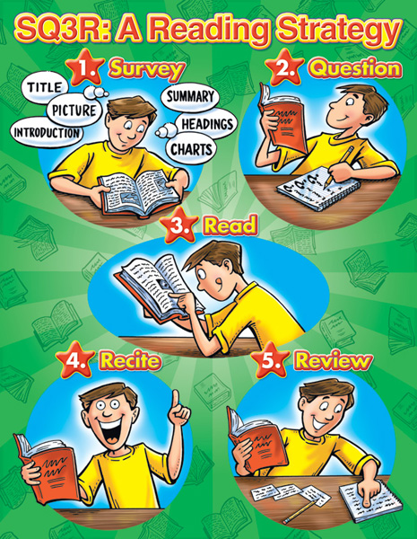
What does SQ3R mean?
Survey!
Question!
Read!
Recite!
Review!

Slide 3

Survey!
Title
Headings and/or sub-headings.
Vocabulary Words
Captions under pictures, charts, graphs and maps.
Review questions and/or study guides.
Introductory and concluding paragraphs
summary

Slide 4

Question!
Turn the title, headings, and sub-headings into questions.
Read questions at the end of the chapters or after each sub-heading.
Ask yourself, “What did my instructor say about this chapter?”
Ask yourself, “What do I already know about this subject?”
Write out your questions.

Slide 5

Read!
Look for answers to the questions you first raised.
Answer questions at the beginning or end of chapters or study guides.
Reread captions under pictures, graphs, etc.
Note all the underlined, italicized, and bold printed words or phrases.
Study graphic aids.
Reduce your speed for difficult passages.
Stop and reread parts that are not clear.
Read only a section at a time and recite after each section.

Slide 6
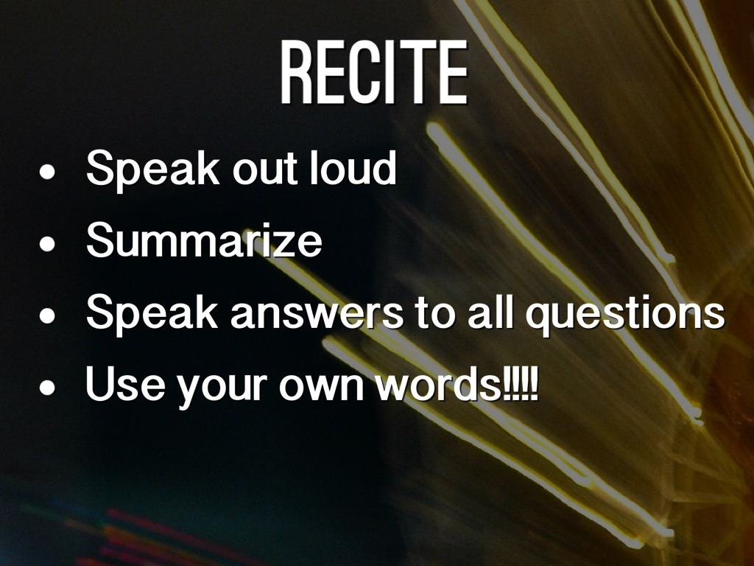
Recite!
Orally ask yourself questions about what you have just read, or summarize, in your own words, what you read.
Take notes from the text, but write important information in your own words.
Teach someone (your parents?) about what you read.
Quadruple strength learning: Seeing, saying, hearing, and writing!

Slide 7
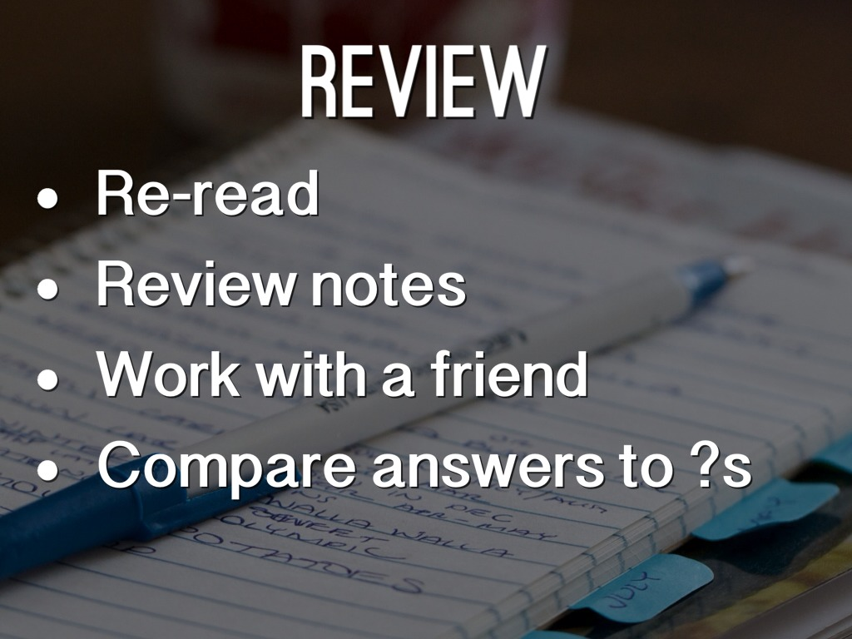
Review!
Write questions for the notes you have taken.
Complete the SQ3R Organizer worksheet and put it with your notes.
Read over your notes and worksheet before lecture/quiz/test.

Slide 8


